Slide 1
Why It’s Important To Know We’re Doing The Right Thing…
Assessments Of ‘Appropriateness’ In Evaluations
Presented by Dr Roberta Ryan and Dr Ania Wilczynski
August 2011

Slide 2
Where does appropriateness fit as part of evaluation?

Slide 3
Front end
Planning
Research
Research
Implementation
Review
Research

Slide 4
Why is it important?
Principles into practice
Planning
  Appropriateness
  Effectiveness
  Sustainability
Evaluate
Evaluate
Future Directions
  Appropriateness
  Effectiveness
  Sustainability
Implementation
  Appropriateness
  Effectiveness
  Sustainability
Evaluate

Slide 5
What is evaluation?
Evaluation is the systematic collection of information about the activities and outcomes of programs to:
  track progress
  make judgements and decisions
  improve effectiveness
  build understandings.
Note: (i) involves values (ii) systematic (iii) variety of uses

Slide 6
Different purposes
Judge merit or worth
Improve programs
Generate knowledge/understandings
Be accountable to the project’s investors and gain/maintain support

Slide 7
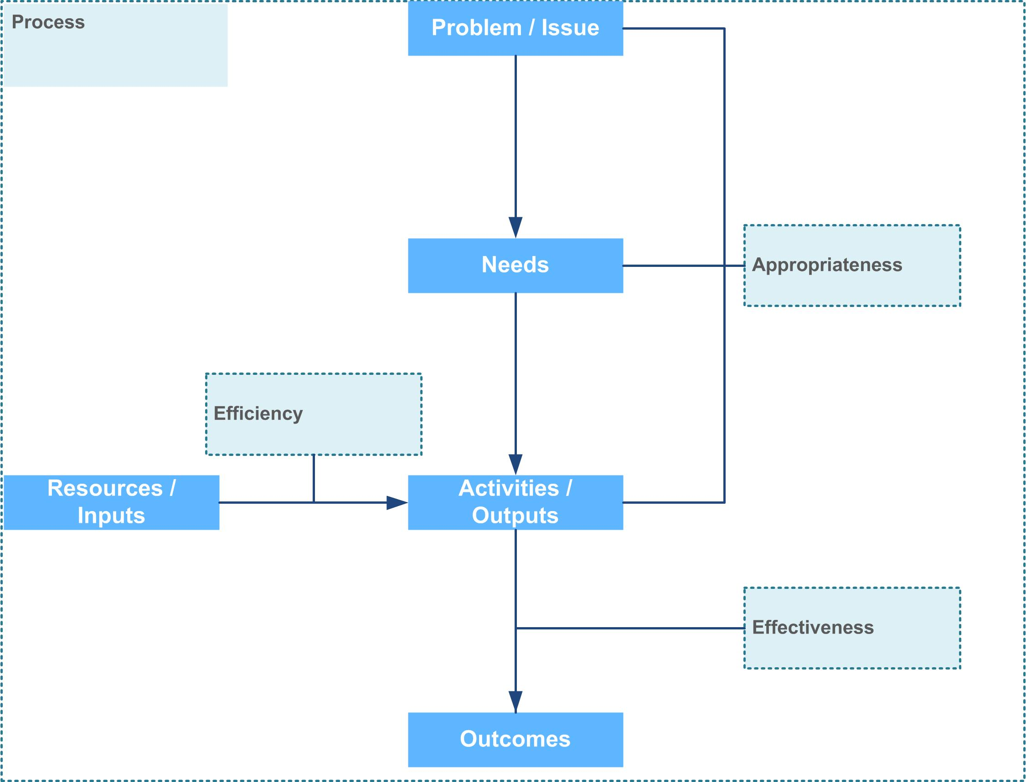
What should I evaluate – the logic of a program

Slide 8
What should I evaluate?
Depending on purpose, evaluate one or more of:
Appropriateness (does it make sense?)
  Does the program address the right issues, is there a need ?
  Do the objectives address the need?
Effectiveness (did it work?)
  Did the program achieve the desired objectives/outcomes?
Efficiency (was it cost effective?)
  Could we have made better use of resources?
Process (was it well managed?)
  Did the method for making decisions and managing the project ensure it’s success?

Slide 9
EXAMPLES

Slide 10
Example 1 – D&A education
The program is:
A large Australian Government initiative
Aimed at reducing substance abuse amongst young people
Operated and managed by a research organisation, who leads a consortium of partner agencies
Activities include:
  research and clinical activities
  workforce development
  service delivery
  social marketing and resource development

Slide 11
Issues with program’s appropriateness
A mismatch between the expertise of the funded organisation and the needs the program aims to address
Harm minimisation – a politically sensitive approach
Assumptions made about what young people want
Getting bang for your buck (quantum of activity vs outcomes achieved)
Notes:
A mismatch -a research organisation was funded to provide substance abuse service delivery, resulting in a weak demonstrated link between the needs the program sought to address and the activities conducted. The funded organisation focused heavily on research activities, despite research not being identified as an explicit aim of the program. Some of the outputs delivered were more closely aligned with achieving the required needs than others; however the distribution of effort and the balance of activities undertaken were not appropriate (eg activities that were less aligned with the needs were given too much emphasis).
Harm minimisation the funded organisation wanted to employ a harm-minimisation approach based on evidence suggesting harm-minimisation can be an effective substance education approach. The Government, however, was not receptive to this approach due to political sensitivity around use of illicit substances and concerns that the Government not be seen to be promoting or condoning drug use. (Interestingly, these sensitivities seem much more apparent at the Commonwealth vs State level)
What do young people want? Assumptions were made about how young people want to be engaged and materials were designed specifically for this demographic, not informed by an evidence base or without involving/consulting with young people during the design of these activities and products.
Getting bang for your buck – the funded organisation undertook many activities across a range of output areas, raising questions about the quantum of activity versus the impact or outcomes achieved. Spreading resources over too many output areas can diminish the impact of activities and raise issues about ‘bang for buck’. Arguably, it would be more appropriate for the program to focus on activities and target groups where the greatest impacts are likely to be yielded.

Slide 12
Example 2 – D&A education
The program:
is a drug and alcohol education program
is targeted at young people
involves a cross-disciplinary arts competition
is a government initiative delivered in partnership with a media organisation
has been in operation for many years

Slide 13
Issues with program’s appropriateness
The expansion of program scope over time
A lack of drug and alcohol expertise
Sending the right (any?) message
Assumptions about what young people want
Notes:
Expansion of program scope – the program began with very specific aims, activities and target audience (based in evidence) but expanded its scope significantly over the years of operation. The expanded scope was not been underpinned by a program logic or similar strategic planning process to link the aims and activities undertaken to the desired outcomes. The lack of budget increases to match the expanded scope and quantum of activity contributed to resources being spread too thinly and impact being diminished. The program also faced difficulties in having to appeal to a much wider target audience.
Drug and alcohol expertise – the funded organisation had expertise in the creative arts but no experience in drug and alcohol education. The government and the program’s Advisory Committee had limited engagement in providing guidance and input into the planning and delivery of the arts competition. This resulted in an imbalance between an emphasis on creativity and skills development and an emphasis on the drug and alcohol education component of the program. Participation in the program was primarily by young people with a professional interest in the arts, and participants were only superficially engaged with drug and alcohol issues.
Sending the right message –the program experienced difficulty in maintaining a subtle, non-didactic approach to drug and alcohol education while ‘staying on message’. In contrast to NCPIC, the program seeks to encourage an open and honest discussion about drugs and alcohol amongst the target audience without being judgemental or moralising. This created a tension in being an effective drug and alcohol education initiative.
Assumptions about what young people want – similar to NCPIC assumptions were made about how yp want to be engaged (ie online) but not necessarily true. It was recommended that further involvement of young people in the planning and delivery of PNAN activities and products would be beneficial. Not sure if you want a separate dot point here (maybe repetitive), but might be worth drawing the comparison anyway

Slide 14
Example 3: youth D&A program
An Australian Government initiative
Aimed at reducing specific forms of substance abuse amongst young people, including Indigenous
Funded a large number/diverse range of youth programs (grant based)
Evidence base suggests holistic approach preferable
Appropriateness not evaluated, but questionable link with intended outcomes
Therefore could have been funded under e.g. mental health, criminal justice, family services

Slide 15
Example 4 - prevention programs - sustainability
Evaluations and meta evaluations of prevention programs
Widespread use of program logic
Base line measures set
Needs identified
Activities run
Evaluation outcomes

Slide 16
Example 4: prevention programs – sustainability
Not clear link between need and activities
Use of captive audience for delivery
Limited evidence to support processes used
Problems with critical mass
Attribution very difficult

Slide 17
Example 5: child protection
Cross jurisdictional
Capture of significant existing programs under ‘new’ policy and delivery focus
Concern with appropriateness question – not ‘purpose designed’
Focus on the most disadvantaged
Small numbers of families – multiple interventions
Overlay of program logic after program design
Very high level outcomes – vast gap between activities and wellbeing of children

Slide 18
Conclusions
Appropriateness is often forgotten or resisted
Can be the most important!
Can be at the intersection between political decisions and bureaucratic accountability
Desire for a holistic approach can contribute to inappropriate activities

Slide 19
Conclusions – common dimensions
Organisational - dependence and expertise
Attribution – complexity and interdependence (especially where holistic approach desirable)
Assumed process
Spread too thin – too little to do too much
Critical mass of investment
Needs analysis and basic research
Evidence base may be either absent/partial, ignored, or used too broadly to influence program design
Notes:
Attribution issue – particularly prone to happen where complex issues, where the evidence indicates you need a holistic response eg child protection, substance abuse, young people with substance abuse problems.
Evidence base may be either:
absent/partial – so isn’t clear what activities will lead to the desired outcomes
ignored - in a recent talk Sandra Jones (Director of the Centre for Health Initatives at the Uni of Wollongong) described how there is a mismatch between which strategies work in the alcohol policy field and those which govts tend to support. For example:
- Some strategies work, and Some strategies work, and we do them:
eg Drink driving interventions, individual interventions with at‐risk drinkers
- Some strategies work, but we still don’t do them:
eg Increasing price, reducing availability, banning alcohol advertising
- Some strategies don’t work, but we do them anyway
eg School based education, public information campaigns, industry‐funded campaigns
- Used too broadly – eg a ‘holistic approach’ means a program has no specific link to the problem it is seeking to address (eg substance abuse)

Slide 20
What to do?
Bring experts into the process
Consider appropriateness when designing program and implementation, not after
Interrogate process – what and who
Do preliminary needs analysis work
Manage time
Don’t spread resources too thin

Slide 21
Why It’s Important To Know We’re Doing The Right Thing…
Assessments Of ‘Appropriateness’ In Evaluations
Presented by Dr Roberta Ryan and Dr Ania Wilczynski
August 2011

